Slide 1
Approximation Algorithm
Updated on 2012/12/25

Slide 2
Approximation Algorithm
Up to now, the best algorithm for solving an NP-complete problem requires exponential time in the worst case. It is too time-consuming.
To reduce the time required for solving a problem, we can relax the problem, and obtain a feasible solution “close” to an optimal solution

Slide 3
Approximation Algorithm
One compromise is to use heuristic solutions.
The word “heuristic” may be interpreted as “educated guess.”

Slide 4
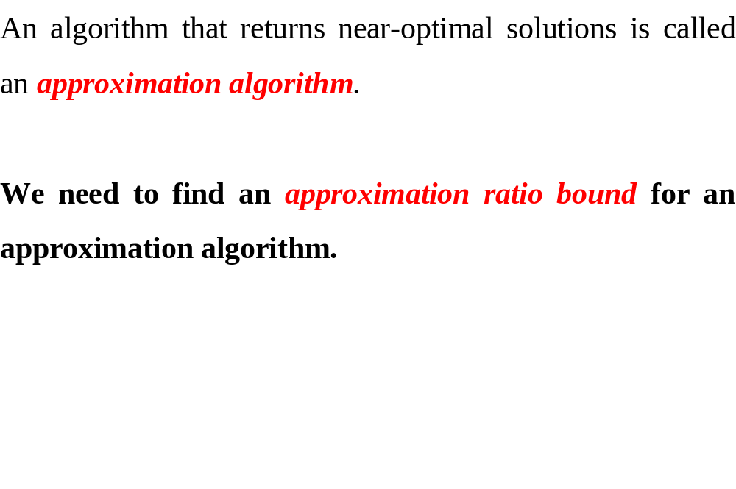
Approximation Algorithm

Slide 5
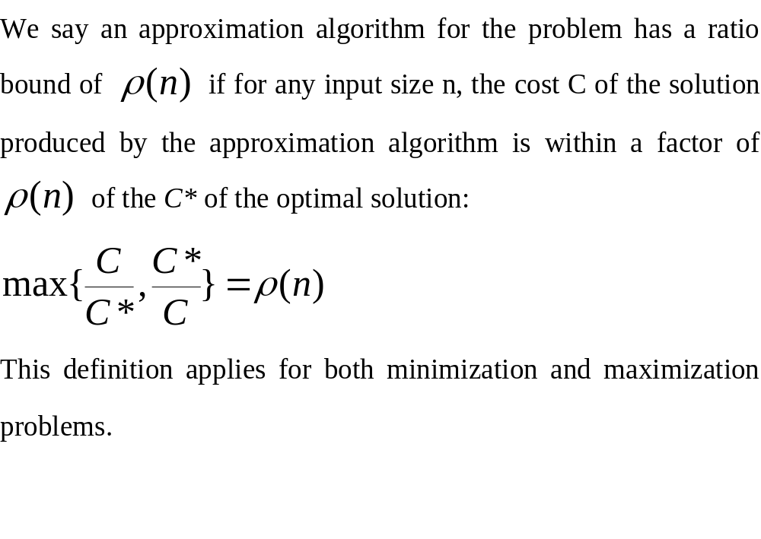
Approximation ratio bound

Slide 6
ρ-approximation algorithm
An approximation algorithm with an approximation ratio bound of ρ is called a ρ-approximation algorithm or a (1+ε)-approximation algorithm.
Note that ρ is always larger than 1 and ε=ρ-1.

Slide 7
Vertex Cover Problem
Let G=(V, E). The subset S of V that meets every edge of E is called the vertex cover.
The Vertex Cover problem is to find a vertex cover of the minimum size. It is NP-hard or the optimization version of an NP-Complete decision problem.

Slide 8
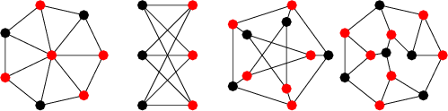
Examples of vertex cover

Slide 9
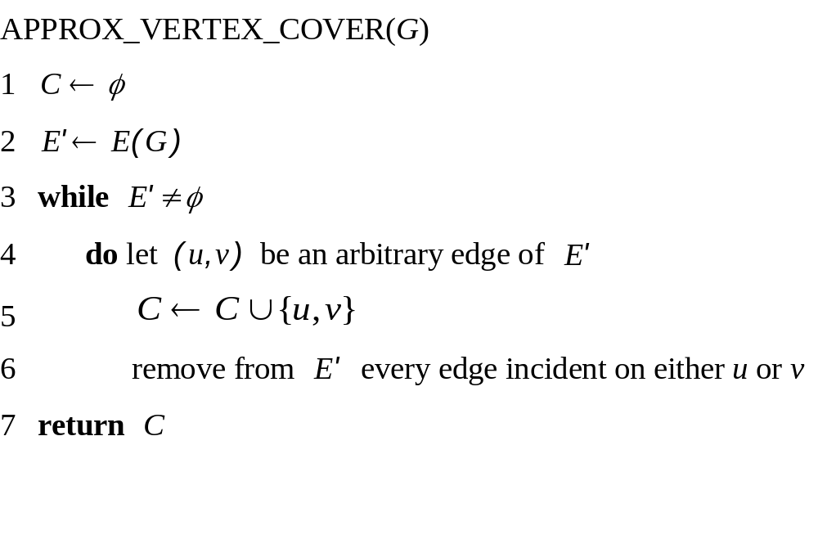

Slide 10
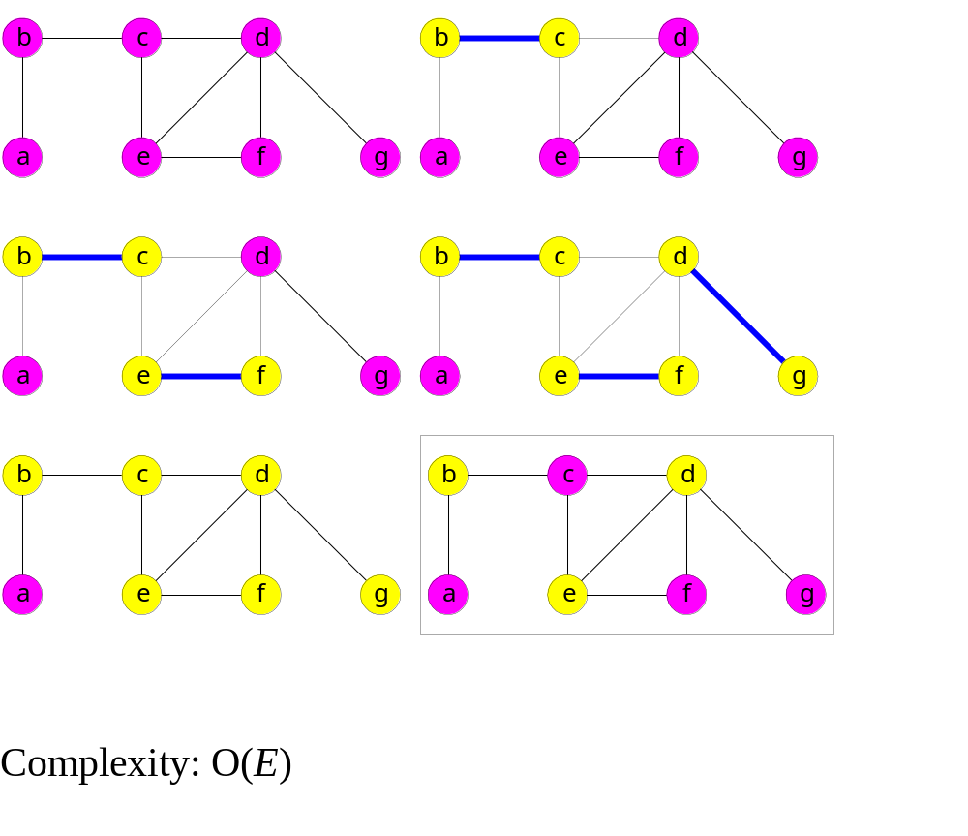

Slide 11
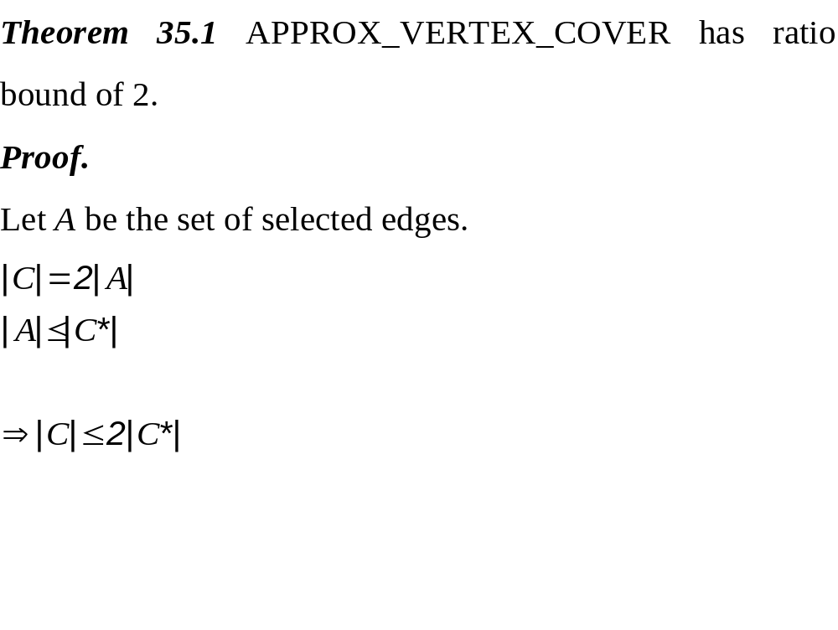
C*: optimal solution
C: approximate solution
A: the set of edges selected in step 4
When one edge is selected, 2 vertices are added into C.
No two edges in A share a common endpoint due to step 6.

Slide 12
Bin Packing Problem
Given n items of sizes a₁, a₂, …, a_{n}, 0< a_{i} ≤ 1 for 1 ≤ i ≤ n, which have to be placed in bins of unit capability, the bin packing problem is to determine the minimum number of bins to accommodate all items.
If we regard the items of different sizes to be the lengths of time of executing different jobs on a standard processor, the problem becomes to use minimum number of processors which can finish all of the jobs within a fixed time. //You can assume the longest job takes one unit time, which equals to the fixed time.

Slide 13
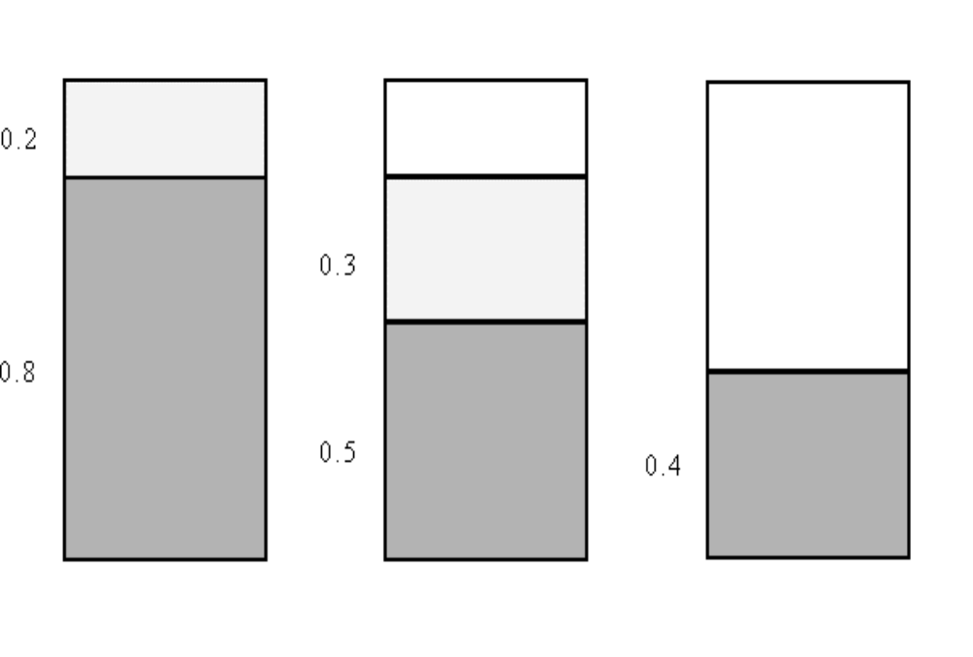
Example of Bin Packing Problem
E.g. Given n = 5 items with sizes 0.3, 0.5, 0.8, 0.2 0.4, the optimal solution is 3 bins.
The bin packing problem is NP-hard.

Slide 14
An approximation algorithm for the bin packing problem
An approximation algorithm: (first-fit) place item i into the lowest-indexed bin which can accommodate it.
OPT: the number of bins of the optimal solution
FF: the number of bins in the first-fit algorithm
C(B_{i}): the sum of the sizes of items packed in bin B_{i} in the first-fit algorithm
Let FF=m.

Slide 15
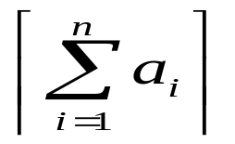
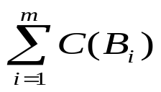
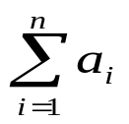
An approximation algorithm for the bin packing problem
OPT ≥ , ceiling of sum of sizes of all items
C(B_{i}) + C(B_{i+1}) > 1 (a)(Otherwise, the items in B_{i+1} will be put in B_{i}.)
C(B₁) + C(B_{m}) > 1 (b)(Otherwise, the items in B_{m} will be put in B₁. )
For m nonempty bins,
C(B₁)+C(B₂)+…+C(B_{m})>m/2, (a)+(b)for i=1,..,m
⇒ FF = m < 2 = 2 ≤ 2 OPT
FF < 2 OPT
C(Bi): the sum of sizes of items packed in bin Bi

Slide 16
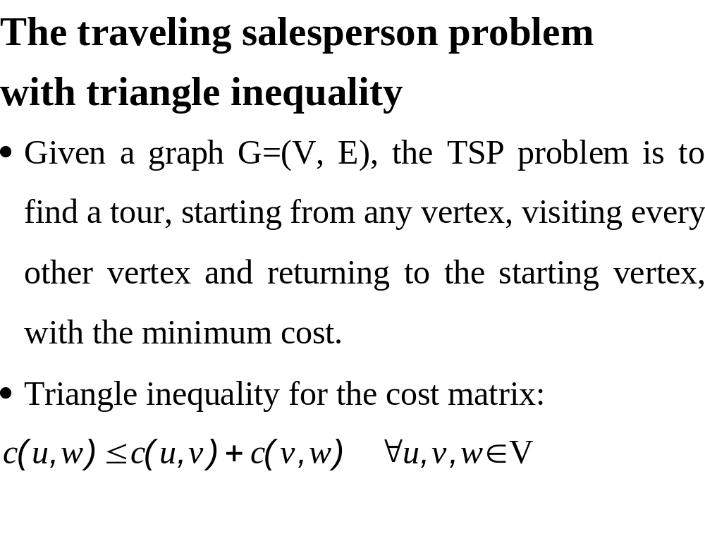

Slide 17
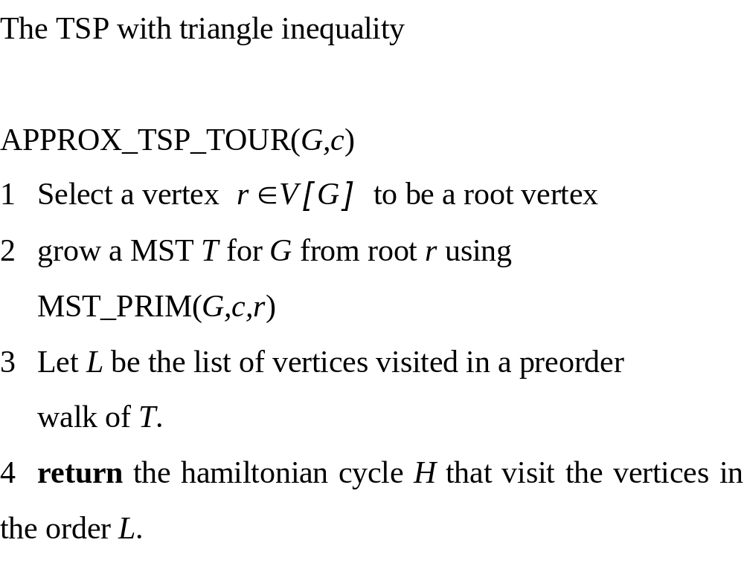

Slide 18
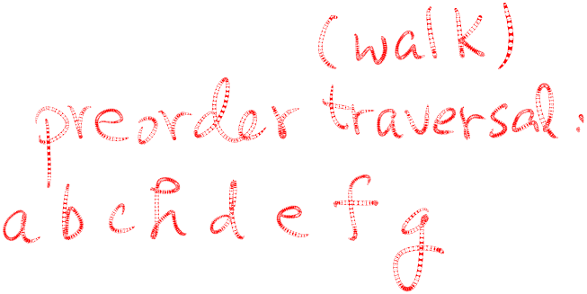
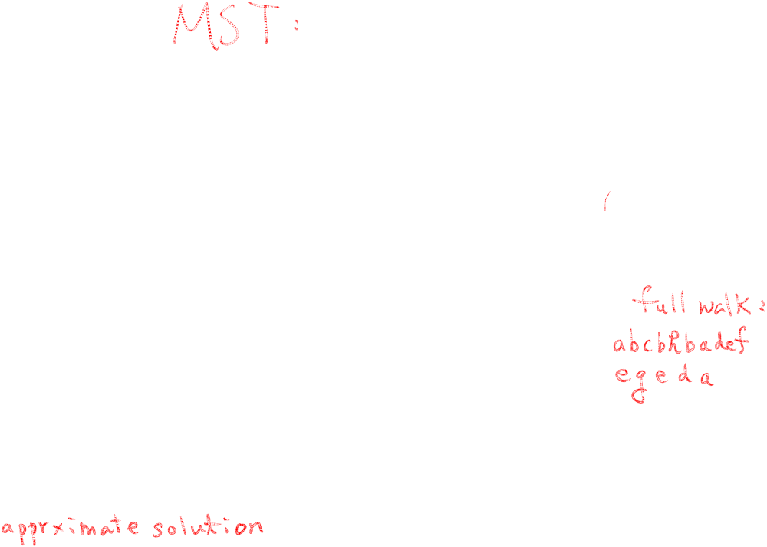
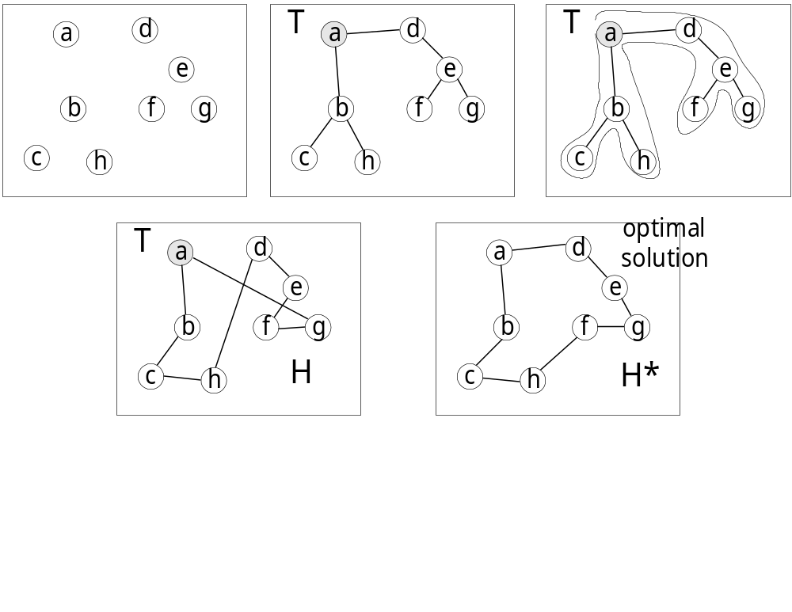

Slide 19
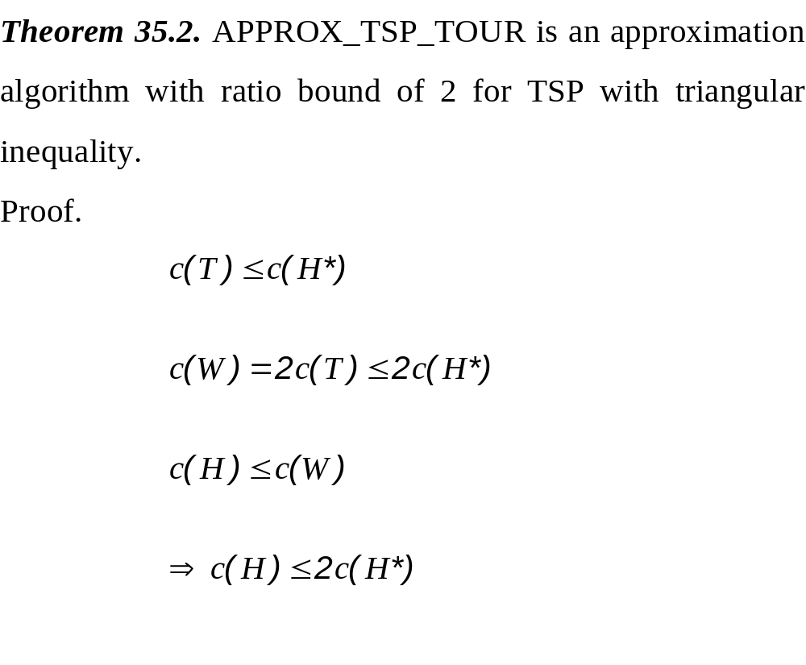
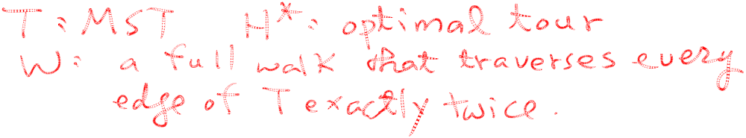
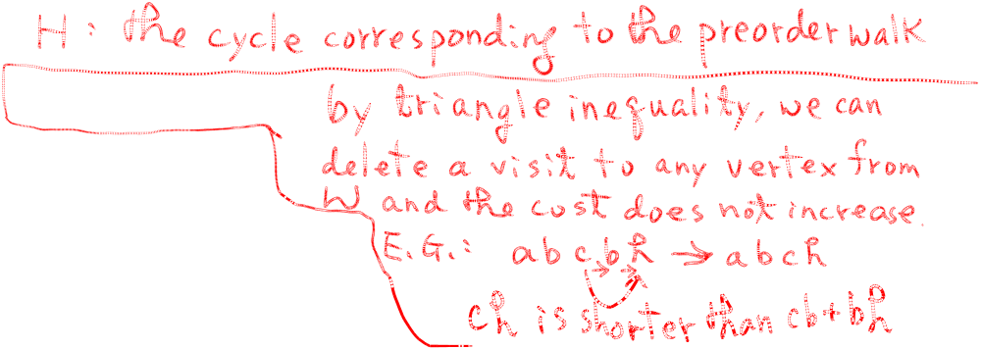

Slide 20
An approximation algorithm for Euclidean traveling salesperson problem (ETSP)
The ETSP is to find a shortest closed path through a set S of n points in the plane.
The ETSP is NP-hard.

Slide 21
Approximation Algorithm for ETSP
Input: A set S of n points in the plane.
Output: An approximate traveling salesperson tour of S.
Step 1: Find a minimum spanning tree T of S.
Step 2: Find a minimum Euclidean weighted matching M on the set of vertices of odd degrees in T. Let G=M∪T.
Step 3: Find an Eulerian cycle of G and then traverse it to find a Hamiltonian cycle as an approximate tour of ETSP by bypassing all previously visited vertices.

Slide 22
Eulerian Cycle
An Eulerian path (Eulerian trail, Euler walk) in a graph is a path that uses each edge precisely once. If such a path exists, the graph is called traversable.
An Eulerian cycle (Eulerian circuit, Euler tour) in a graph is a cycle with uses each edge precisely once. If such a cycle exists, the graph is called Eulerian.

Slide 23
L. Euler showed that an Eulerian cycle exists if and only if all vertices in the graph are of even degree and all edges are contained in the same component.
L. Euler also showed an Eulerian path exists, if and only if at most two vertices in the graph are of odd degree and all edges are contained in the same component.

Slide 24
Leonhard Euler (April 15, 1707 - September 18, 1783) (pronounced "oiler") was a Swiss mathematician and physicist. He is considered (together with Gauss) to be the greatest mathematician ever.
Leonhard Euler stated and solved the problem of Seven Bridges of Königsberg in 1736, which is the first formally discussed problem in graph theory.

Slide 25

Eulerian Cycle exists because
degree(V1) = 4
degree(V2) = 2
degree(V3) = 4
degree(V4) = 4.

Slide 26

This is the Eulerian Cycle.

Slide 27
A Hamiltonian path (also called traceable path) is a path that visits each vertex exactly once.
A Hamiltonian cycle (also called Hamiltonian circuit, vertex tour or graph cycle) is a cycle that visits each vertex exactly once, except for the starting vertex.

Slide 28
Minimum Euclidean Weighted Matching (MEWM) Problem
Given a set of points in the plane, the minimum Euclidean weighted matching problem is to join the points in pairs by line segments such that the total length is minimum.

Slide 29
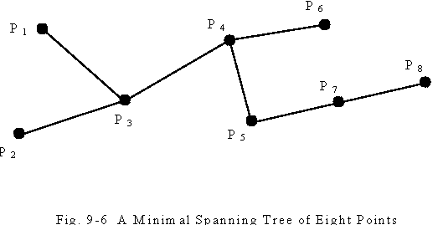
Approximation Algorithm for ETSP
E.g.
Step1:

Slide 30
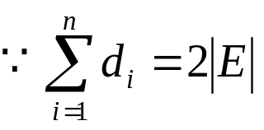
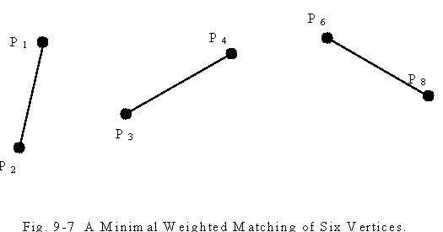
Approximation Algorithm for ETSP
Step2:The number of points with odd degrees must be even. , which is even
One edge contributes 2 degrees

Slide 31
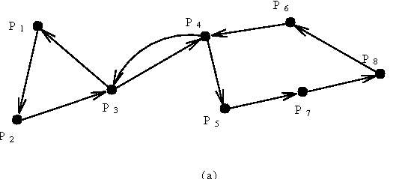
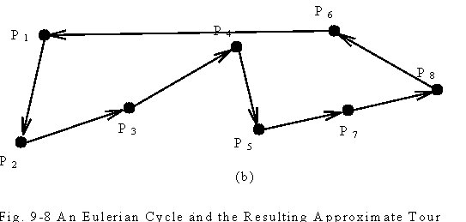
Approximation Algorithm for ETSP
Step3:
P3 and P4 are visited twice.
By bypassing P3 and P4 and connecting P6 to P1 directly, we obtain a Hamiltonian cycle.

Slide 32
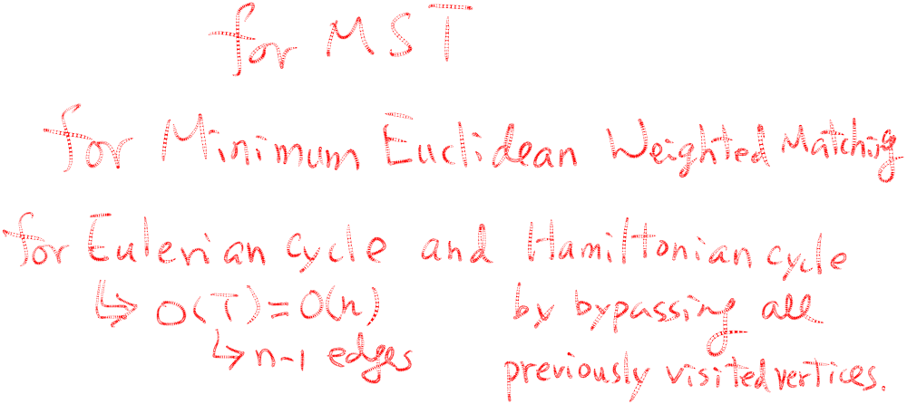
Approximation Algorithm for ETSP
Time complexity: O(n³)
Step 1: O(n log n)
Step 2: O(n³)
Step 3: O(n)
How close the approximate solution to an optimal solution?

Slide 33
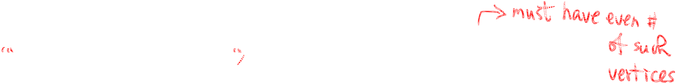
How good is the solution ?
The approximate tour is within 3/2 of the optimal one.
Reasoning:
L: optimal ETSP tour, T: MST, Lp: a path derived by removing one edge from L (Lp is also a spanning tree)
➔ length(T)≤length(Lp)≤length(L)
Let Lp=j₁…i₁j₂…i₂j₃…i_{2m}, where {i₁, i₂,…, i_{2m}} is the set of odd-degree vertices in T where indices of vertices in the set are arranged in the same order as they are in the optimal ETSP tour L.

Slide 34
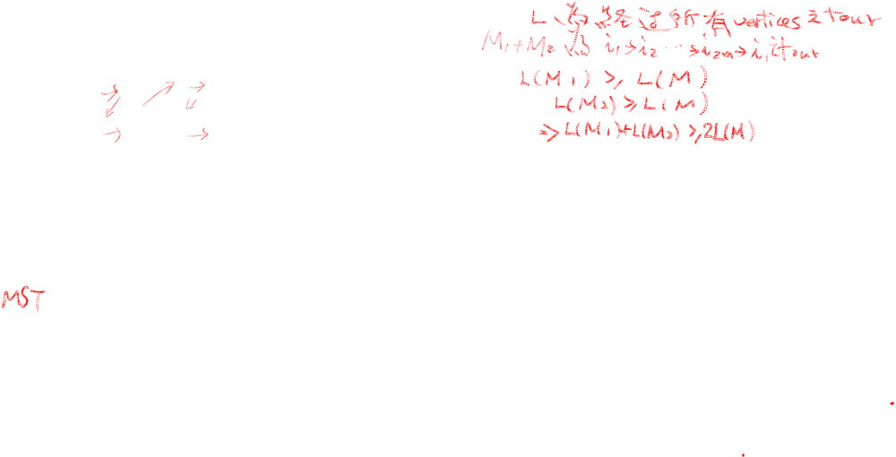
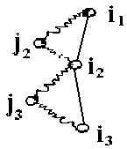

How good is the solution ?
Let M be the minimum Euclidean weighted matching (MEWM).
Consider the two matchings:
M₁={[i₁,i₂],[i₃,i₄],…,[i_{2m-1},i_{2m}]} and M₂={[i₂,i₃],[i₄,i₅],…,[i_{2m},i₁]}. We have
(by triangular inequality)
length(L) ≥ length(M₁) + length(M₂) ≥ 2 length(M )
⇒ length(M)≤ 1/2 length(L )
G = T∪M
⇒ length(T) + length(M) ≤ length(L) + 1/2 length(L)
= 3/2 length(L)

Slide 35
Q&A

